Slide 1
RESTAURANT MANAGEMENT SYSTEM
Name: Kamaljeet kaur
Student Id: 199695740

Slide 2
Introduction: It is a website that allows the customers quickly and easily manage a online
menu which customers can browse and use to place orders with just few clicks. Also customers can book the tables according to their choices.
Scope of the project: This website presents an interactive and up-to-date menu with all available options in an easy to use manner.
It simplifies the order process for both customer and restaurant.
Also customer gets order confirmation details. Once the order is placed it is entered in the database and retrieved in pretty much real time. This allows Restaurant employees to quickly go through the orders as they are received and process all orders efficiently and effectively with minimal delays and confusion.
PHP: It is a general purpose programming language that is originally designed for web development and it stands for Hypertext preprocessor. Also various web template systems and web frameworks are used in it.
There are five characteristics that makes PHP practically possible which are simplicity, efficiency, security, flexibility and familiarity.
Cypress: It is a open source and front end testing tool that perform unit testing, integration testing and end to end testing .
It is very useful for recording the tests and taking the screenshots.
Also it displays the readable errors that makes the debugging easy and fast.

Slide 3
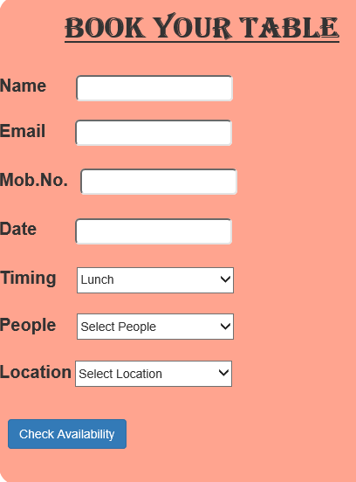
Project screenshot:
Table booking form

Slide 4
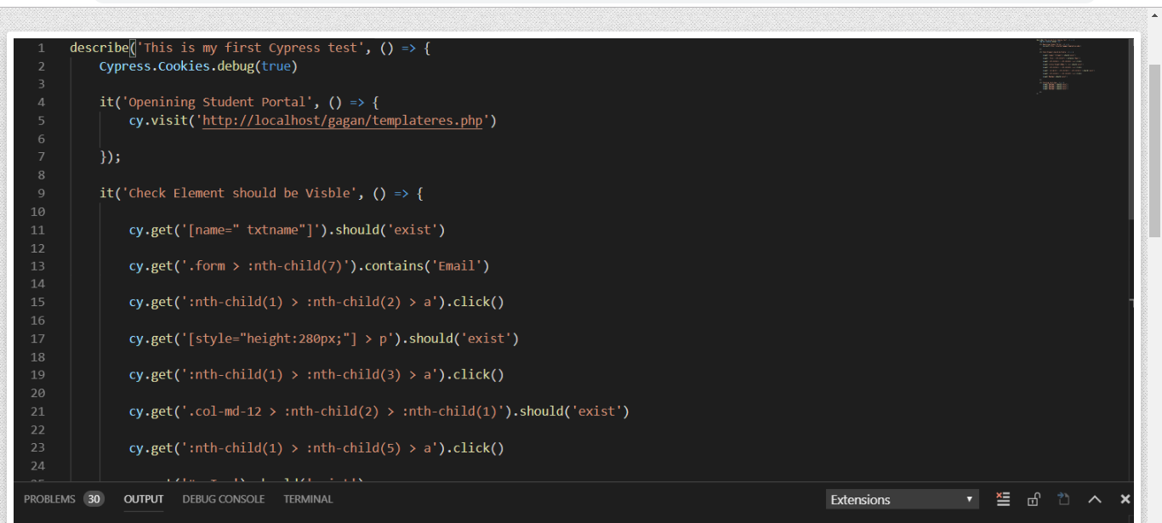
Test cases in cypress:

Slide 5
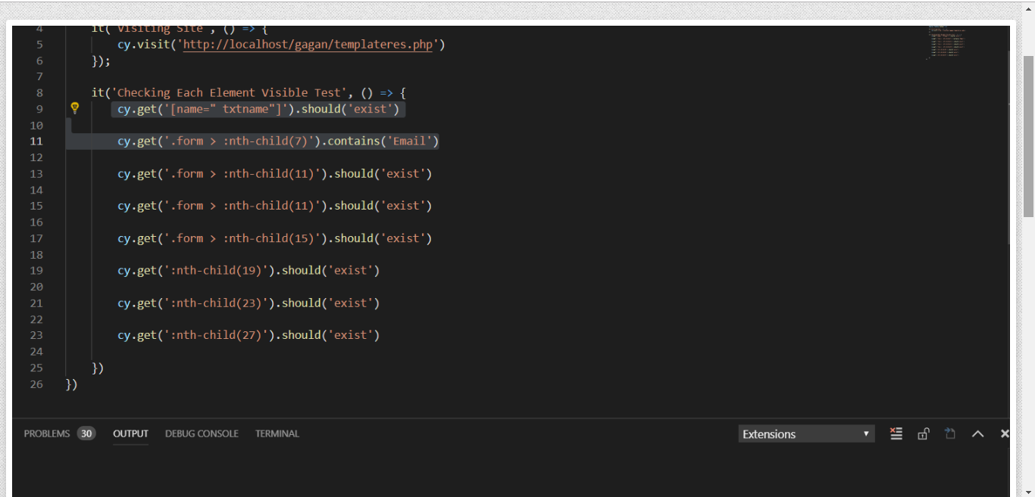

Slide 6
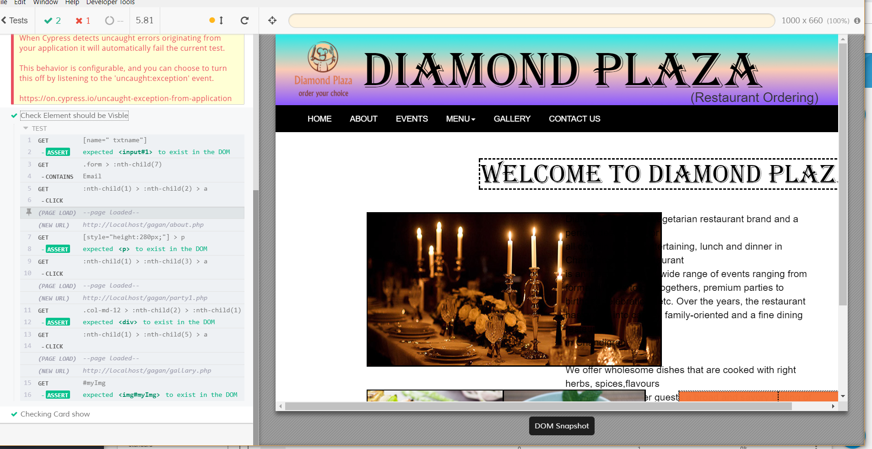

Slide 7
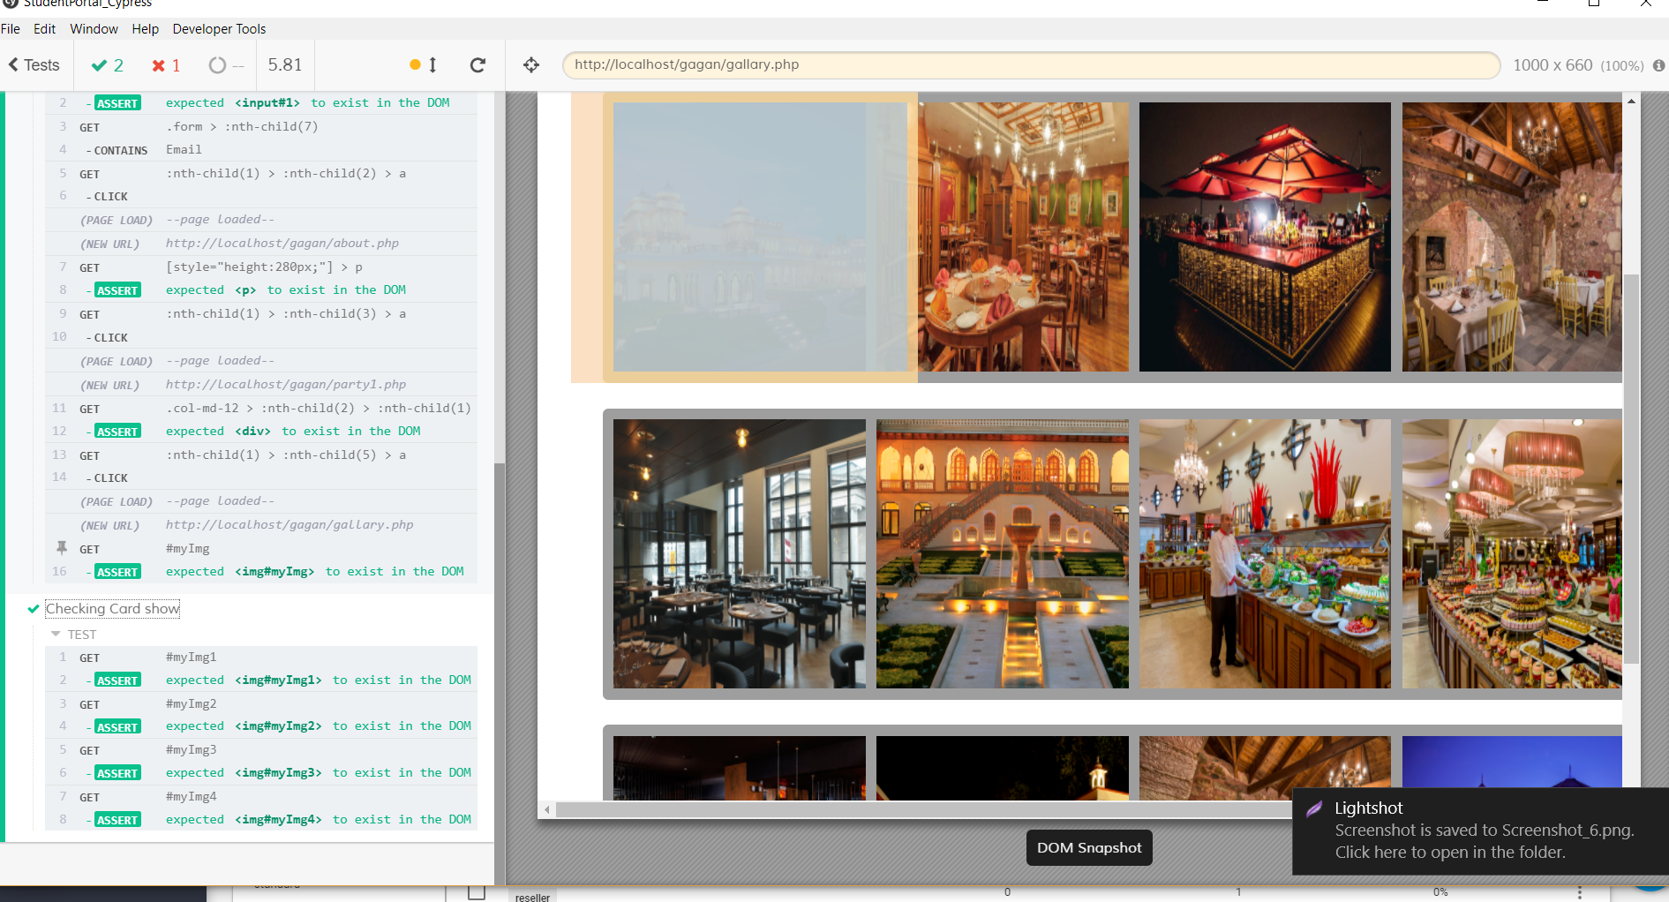

Slide 8
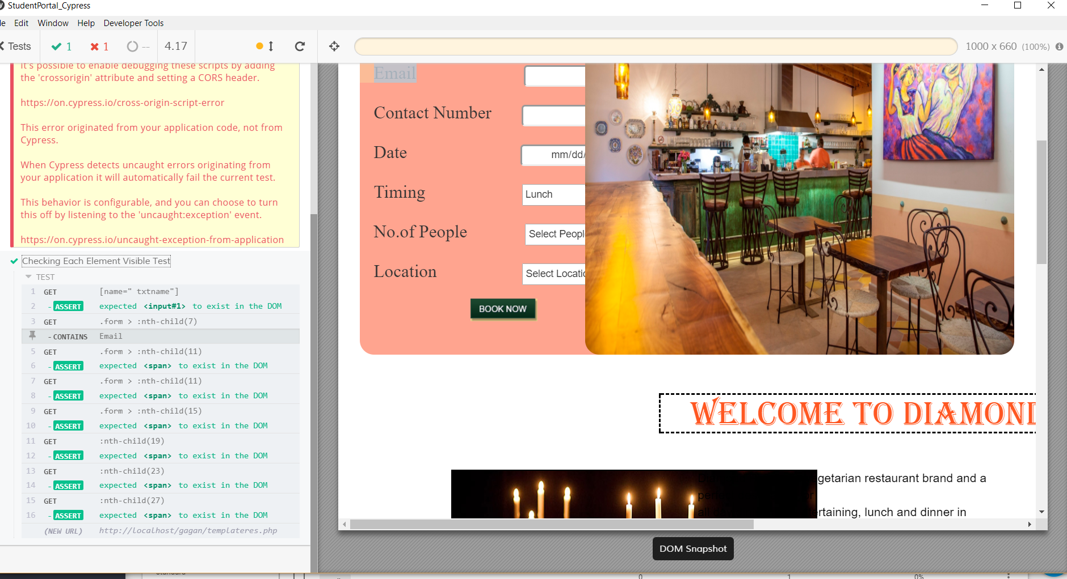
Pipeline:
Pipeline: It is not working because server is not found and it is not locally available. It also shows error while logging in Jenkins.

